Slide 1


Verilog Project Booth Multiplier
Prepared by: Het K. Soni
(19EC073)
EC Department
Guided by: Prof. Dhara P. Patel
Prof. Arpan Desai

Slide 2
Flow Of Presentation
Introduction
Working of Booth’s Algorithm
Flow chart
Code and Output waveforms
Need of Booth’s algorithm
Applications
References

Slide 3
Introduction
Multiplier is a must in any computing system. After addition and subtraction a multiplier hardware always makes work simpler.
Found by Andrew Donald Booth.
Booth's multiplication algorithm is a multiplication algorithm that multiplies two signed binary numbers in two's complement notation.

Slide 4
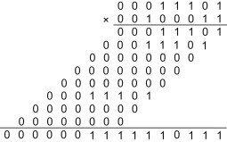
Shift & Add Multiplication Method

Slide 5
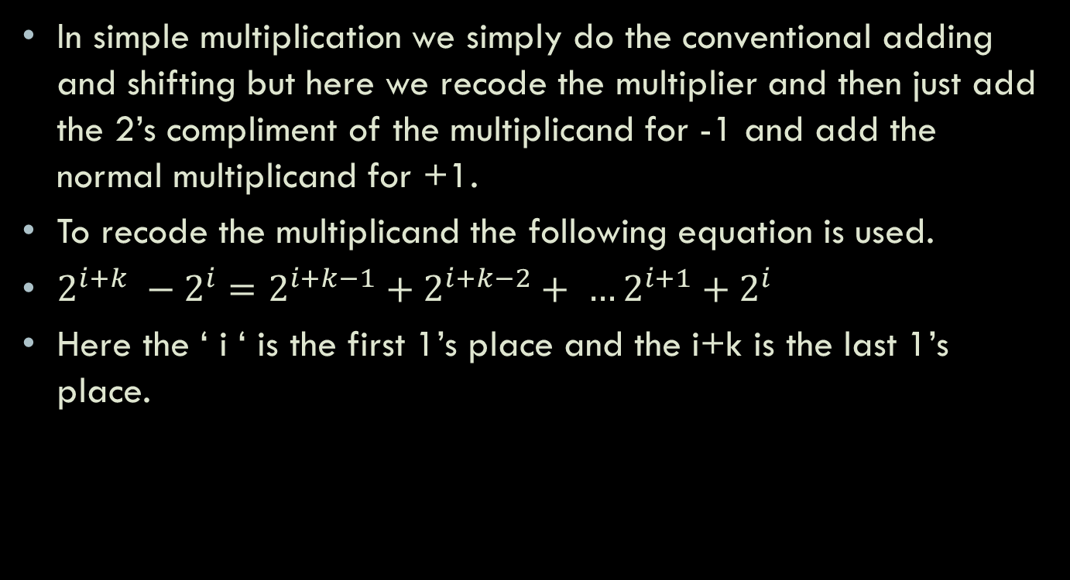
Booth’s Multiplication
In simple multiplication we simply do the conventional adding and shifting but here we recode the multiplier and then just add the 2’s compliment of the multiplicand for -1 and add the normal multiplicand for +1.
To recode the multiplicand the following equation is used.
$2^{i+k} −2^{i}=2^{i+k−1}+2^{i+k−2}+ …2^{i+1}+2^{i}$
Here the ‘ i ‘ is the first 1’s place and the i+k is the last 1’s place.

Slide 6
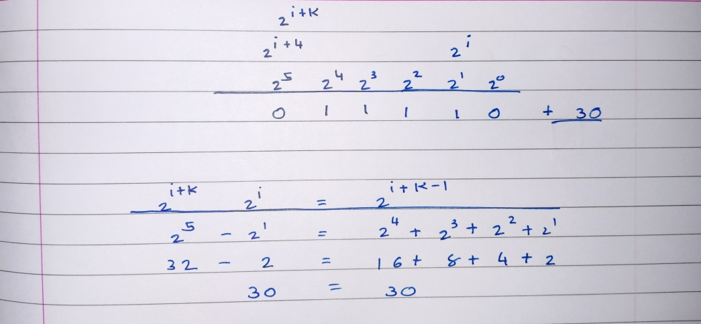
Here multiplier can be recoded as deference of two numbers.
Here 32 - 2

Slide 7
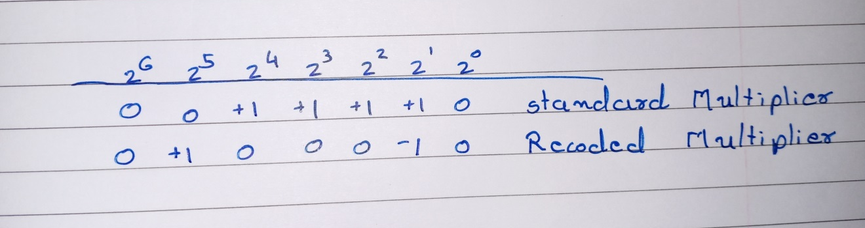

Here the product is generated by one addition in the $2^{i+k}$ term and one subtraction in the $2^{i}$term.
Here k is the number of consecutive 1’s.

Slide 8
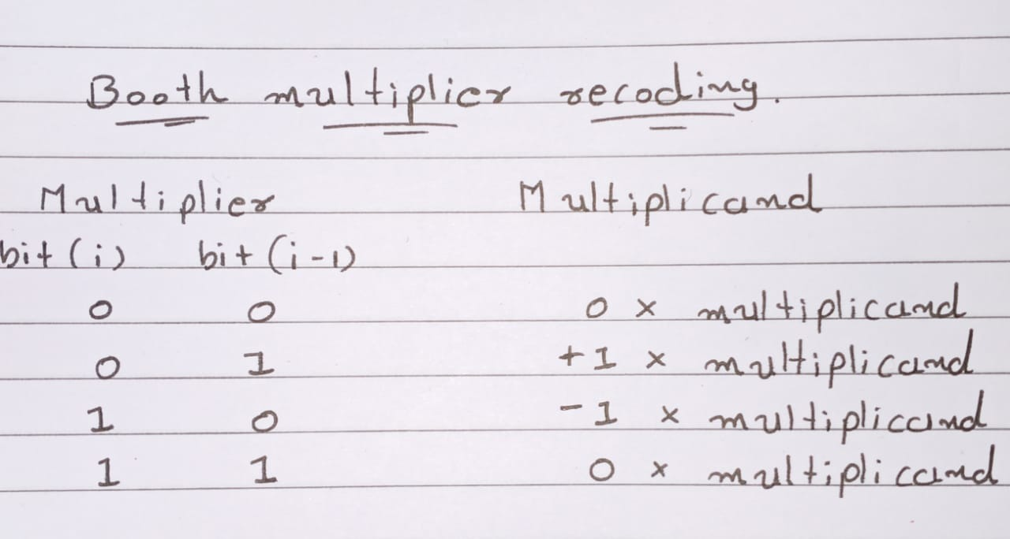
In terms of Booth Multiplier algorithm …

Slide 9
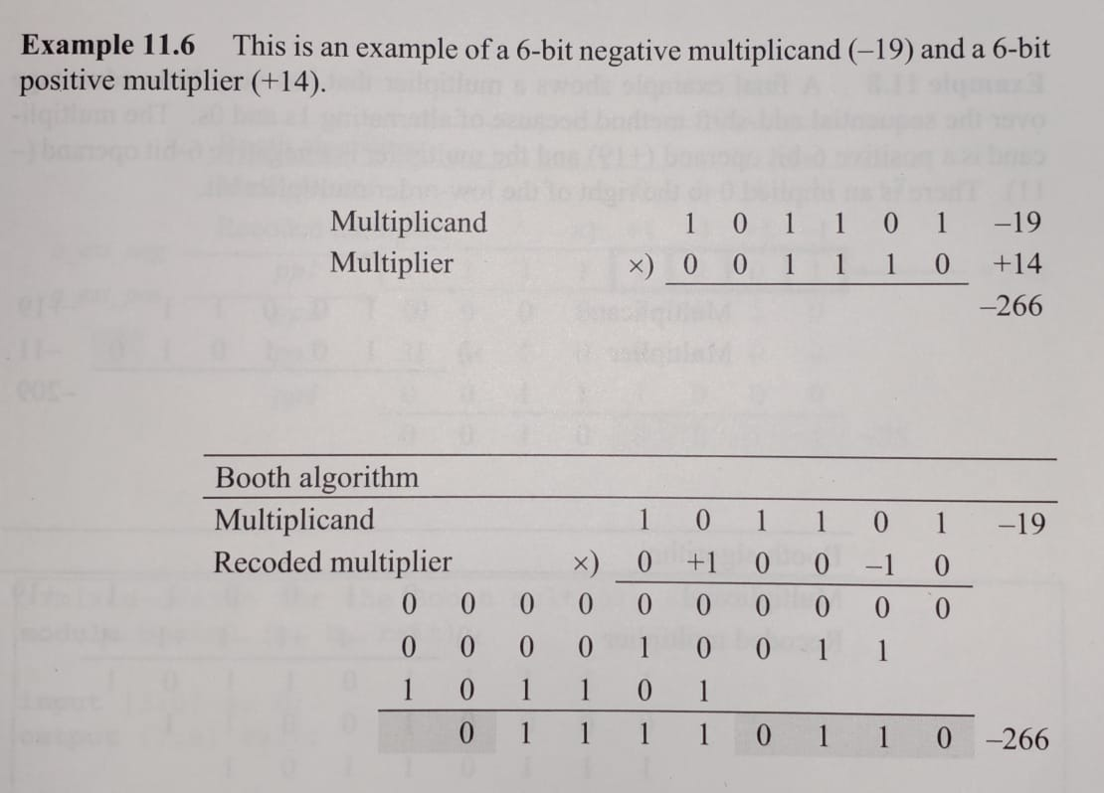
Booth algorithm example…

Slide 10
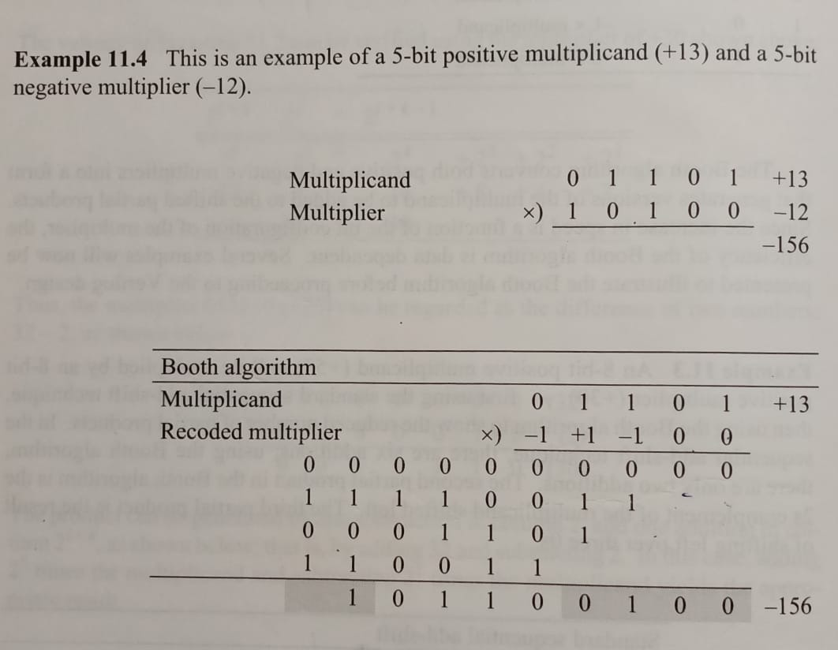
Booth algorithm example…

Slide 11
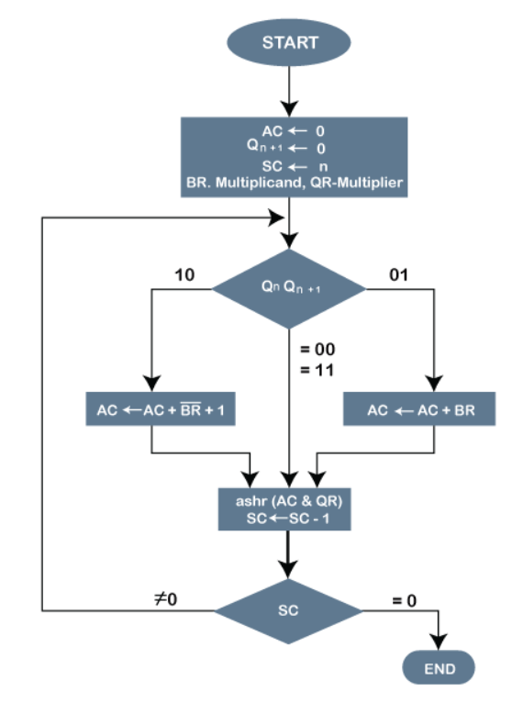
Flow chart

Slide 12
Code and Simulation Results

Slide 13
Need of Booth’s Algorithm
The booth algorithm is a multiplication algorithm that allows us to multiply the two signed binary integers in 2's complement, respectively. It is also used to speed up the performance of the multiplication process. It is very efficient too.
Booth and modified booth… (Radix-4 multiplication by 0 or +1, +2 or -1 or -2)

Slide 14
Applications
Booth multiplier plays a major role in digital integrated circuits.
Booth used desk calculators that were faster at shifting than adding and created the algorithm to increase their speed of arithmetic operations.
One advantage of the Booth multiplier is, it reduce the number of partial product, thus make it extensively used in multiplier with long operands (>16 bits). The main disadvantage of Booth multiplier is the complexity of the circuit to generate a partial product bit in the Booth encoding.

Slide 15
References
Verilog HDL Digital design and modeling by Joseph Cavanagh
https://www.asic-world.com/
https://link.springer.com/chapter/10.1007
https://en.wikipedia.org/wiki/Booth%27s_multiplication_algorithm
https://www.javatpoint.com/booths-multiplication-algorithm-in-coa
https://www.efxkits.us/modified-booth-algorithm/

Slide 16
Thank you

